Slide 1
Windows Upgrade Readiness
Fred Bainbridge
Fredbainbridge.com
fred@mnscug.org
Microsoft MVP, Enterprise Mobility
Now Micro
Steve Jesok
Jesok@mnscug.org
Sr Design Engineer
Ameriprise

Slide 2
Fred Bainbridge
Steve Jesok
@FredBainbridge
@SteveJesok
Microsoft MVP, Enterprise Mobility
IT Pro Community Guru
PowerShell, Automation, Blog
System Mgmt. & Automation
Brews Beer
Musician

Slide 3




Get Involved
Forums, reddit, slack, etc.

Slide 4
What are we doing here?
Windows Upgrade Readiness is for in place upgrades.
Windows 7 and 8.1 -> 10
Windows 10 servicing (i.e. 1511 to 1703)
IN PLACE UPGRADES WORK
Notes:
Who has done in place upgrades? How many? What’s your feedback? What surprised you? What were blockers?
In place upgrades do actually work. I just wanted to make that very clear. It’s a brave new world. Also, all consumer upgrades shared telemetry data allowing for the process to be iterative and improve over time.

Slide 5
Tips for successful in-place upgrades
Know what data persists during the upgrade.
Drivers for disconnected devices do not persist.
Use the latest Win10 CU! ConfigMgr offline servicing is helpful here.
Identify your upgrade blockers!
Hardware, Business Units, Applications
Use a ConfigMgr task sequence where possible.
Update BIOS and Drivers during the task sequence.
Start Menu, etc. (things you already do in the task sequence)
Notes:
Who has done in place upgrades? How many? What’s your feedback? What surprised you? What were blockers?
If you are updating a device with disconnected peripheral devices, be aware those drivers will not be present after the upgrade. You can mitigate a lot of this by using the latest win10 release and the latest CU.
When offline servicing your upgrade image, be sure to delete the install.wim.bak file. It isn’t needed and is huge.
Identify your blockers early and get your collections made in configmgr. Use these collections as exclusions when deploying the task sequence as available. Do you have a UEFI and Secureboot requirement? Ram, HD space, etc. Most of your application issues are going to be non-technical, but you still have to prepare for them if you want success.

Slide 6
DEMO - The Web Portal
Play along!
http://mms.micrososf.com
mmsXX@azurelab.org
Notes:
Anyone who wants to can log into a live Windows Upgrade Readiness instance. mm
Who is currently using it? Who know whast it is? Who has set it up?
What is Windows Upgrad Readiness? BIG DATA. Microsoft can you let you know with a high degree of certainty what devices in your environment are ready for a windows 10 upgrade or servicing. There isn’t too much too WindowsUpgrade Readiness. It can be setup and configured quickly and cheaply.
Telemetry telemetry telemetry. If you are not sharing your telemetry data you can’t complain when the product changes but doesn’t address your needs. This is the new normal, adapt.

Slide 7
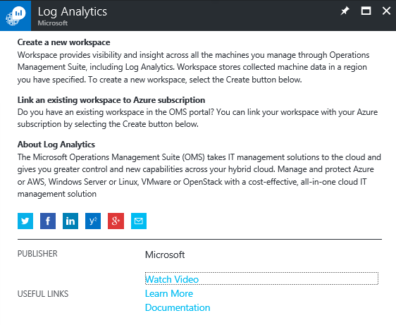
Preparing the Workspace
Azure Subscription
Need admin rights to setup, can be removed later.
Log Analytics / Operational Insight Workspace
The storage and usage is free.
Data snapshots are retained free for 7 days.
Notes:
That’s it. No azure AD needed, but it is nice to tie to a directory, Without azure AD you are using all personal Microsoft accounts.
Getting started –
https://www.microsoft.com/en-us/WindowsForBusiness/upgrade-analytics
When creating the workspace from Azure it is called Log Analytics. Remember, Log Analytics is part of the OMS Suite. OMS itself is not a product. When you add log analytics to a resource group, it creates the Operational Insights workspace. Windows Upgrade Readiness is just an extension of Log Analytics.

Slide 8
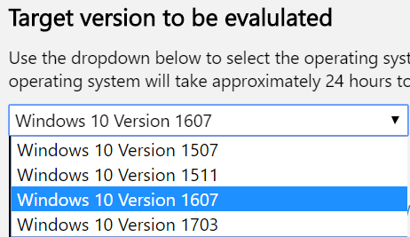
Preparing the Workspace
Azure AD not needed, but can be used if available.
Whitelist the telemetry endpoints.
No infrastructure needed.
What branch do you want to prepare for?
Notes:
That’s it. No azure AD needed, but it is nice to tie to a directory, Without azure AD you are using all personal Microsoft accounts. You will need azure AD if you are going to do PowerShell though, since you cannot authenticate to an azure subscription via PowerShell with a MS account, you need an organization account. You do not need a custom domain though. Blahblah.onmicrosoft.com works fine.
End points –
https://v10.vortex-win.data.microsoft.com/collect/v1 https://vortex-win.data.microsoft.com/health/keepalive https://settings.data.microsoft.com/qos https://go.microsoft.com/fwlink/?LinkID=544713 https://compatexchange1.trafficmanager.net/CompatibilityExchangeService.svc

Slide 9
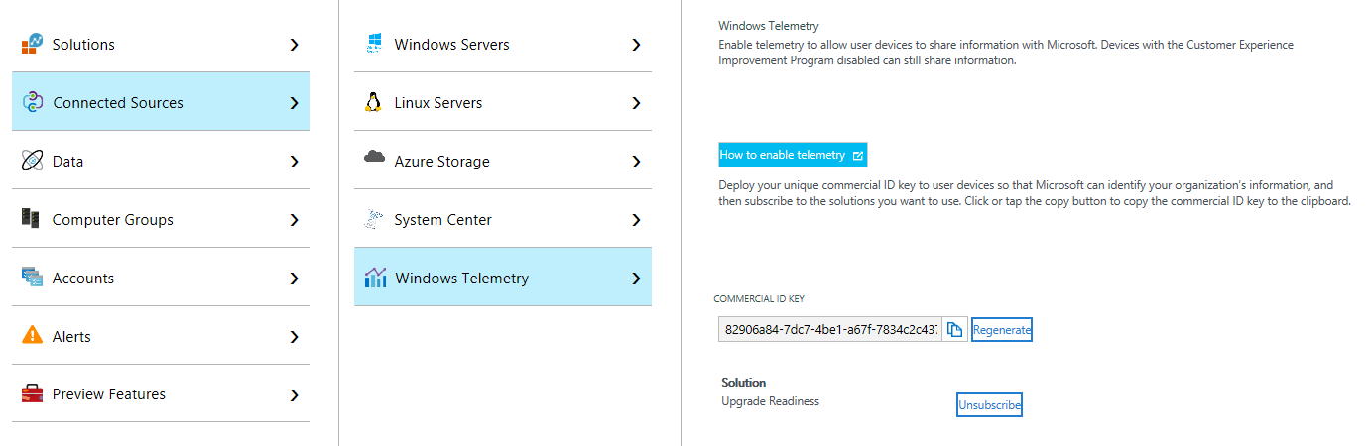
Preparing the Client
Agentless!
Gather your Commercial ID and Enable Telemetry
Notes:
You do NOT need the OMS agent installed on devices you wish to obtain telemetry from. This is very important distinction.
The Commerical ID is located in the OMS workspace web portal.
You don’t really have to enable telemetry. If you run the deployment script and it can communicate to MS end points, you have enabled telemetry. Even if you have a GPO in place to block it.

Slide 10
Preparing the Client
Make sure your devices are patched
KB 2952664 for Windows 7 machines;
KB 2976978 for Windows 8.1 machines;
latest cumulative update for Windows 10 machines)
These update frequently!
Upgrade Readiness Scripts
https://www.microsoft.com/en-us/download/details.aspx?id=53327
How often to run?
Notes:
The KB articles update fairly regularly. Be prepared to keep deploying them. Definitely use an automated solution for this. Keep patching, never stop patching. This is helpful if you plan on using this product, and why not keep using it? Windows 10 will continue to need to be serviced.
It is not an intense amount of data that gets sent, how often is your environment changing? Monthly is probably OK…
If you run the telemetry script, this will enable telemetry regardless of what you set your GPO to.

Slide 11
Simple Deployment Script
set loc="%~dp0"
REM - Copy the script files
XCOPY "%loc%*.bat" "C:\windows\WUA\" /S /E /Y
XCOPY "%loc%*.ps1" "C:\windows\WUA\" /S /E /Y
REM - Install KBs if needed (windows 7 and 8.1)
powershell.exe -ExecutionPolicy Bypass -File "installKBs.ps1"
REM - Schedule the task
SCHTASKS /Create /TN "OMS Windows 10 Update Analytics" /TR "C:\windows\WUA\RunConfig.bat" /SC MONTHLY /RU "SYSTEM" /ST 02:15 /F
REM - Run it one time.
c:\windows\WUA\RunConfig.bat
Notes:
Simple example. This installs the min hotfixes if needed, schedules the analytics to run monthly and run the analytics one time. Logs can be seen in c:\windows\WUA\
Dirtiest script you will ever see. This works, but there are more elegant ways to do it. ConfiMgr Cis / baselines. Etc.

Slide 12
APPLICATIONS
The most important part of any migration project.
Notes:
If you want to look at a migration project as a time breakdown, application packaging and rationalization should be take 90% of your time. The task sequence or deployment method is easy, its been done a thousand times by a thousand different people. You WILL figure out whatever you need to do deploy the actual operating system. Trust me when I say that is the easy part. During the windows 7 migration project, what tooling was available for this? Way too much validation time? Long QA procedures? Other tools to test for appcompat? It was hard work. Anyone use the ACT? Pretty cool huh? Also, pretty labor intensive and complex. It took a jr. data scientist to get good information from that tool and tools of its like. Windows Readiness does all that work for you and with far better results that are actionable.

Slide 13
Upgrade Readiness - Applications
What is actually gathered?
Add Remove Programs (32 and 64)
There is some kind of rationalization happening on the back end.
Does it get everything? YES
Prove it! Analyzing ConfigMgr Installed Applications vs. Windows Upgrade Readiness showed shocking accuracy.
Security Updates are not included in WUR
Microsoft Office, NI and other multi app suites shows as one item in WU.
Windows Upgrade Readiness may finds things that ConfigMgr did not.
(Or be more truthful)
Notes:
If your add/remove programs has custom strings in it, WU can handle that. It determines what the actual application is independent of the Add Remove Programs. This has pretty awesome implications and use cases.
PowerShell examples coming up.

Slide 14
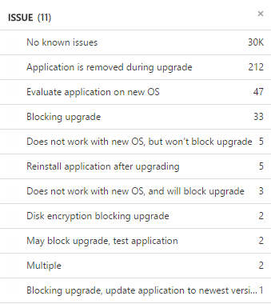

Upgrade Readiness - Applications
Application Issue Status
Notes:
I THINK this is a comprehensive list of application issues.
Type=UAApp | measure count() by Issue

Slide 15
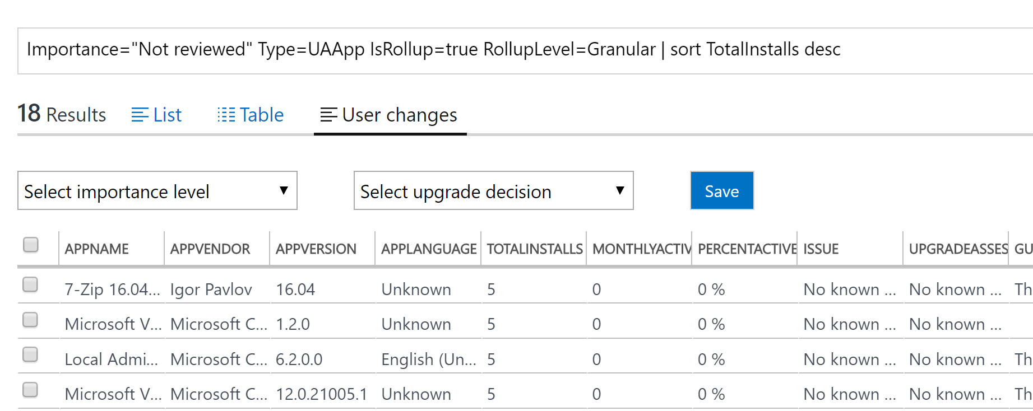
Upgrade Readiness - Applications
List of applications in the environment
Install Count
What devices have the applications
Detailed version information
Importance and Upgrade Decision
Notes:
There is so much good data here. When doing an upgrade project the most important thing to consider is your applications. Everything else is secondary. Users get work done and generate revenue because of the applications they are using, not the OS or the hardware. Ok, so what does Upgrade Readiness get us to help with applications!? An automatically maintained and detailed list. Who used Excel or SharePoint during windows 7 migration project? This web portal can be your source of truth or can be used to cross reference what you think your source of truth is. Use this data as your application rationalization start. Cross reference this against your ConfigMgr app library. Identify your application owners, etc.
Using the telemetry gained from millions of windows 10 upgrades you also are given amazing insight into whether or not an application will work on your windows 10 upgrade or during your windows 10 servicing.
You can assign importance levels and upgrade decision on these applications, meaning you can run your entire windows 10 application readiness from this portal if you want. Set the application to review in process to indicate it is being worked on.

Slide 16
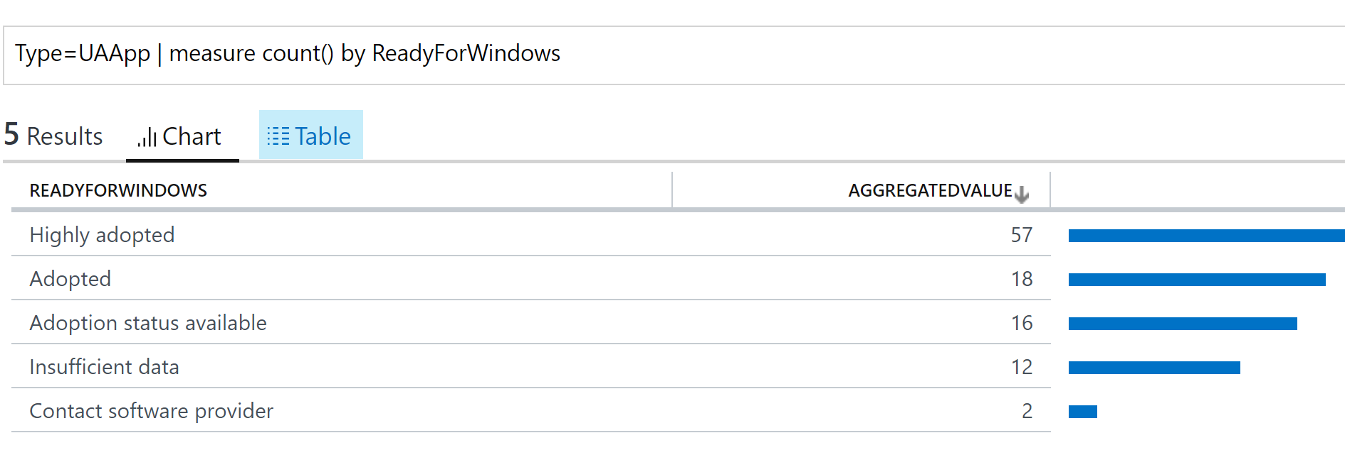
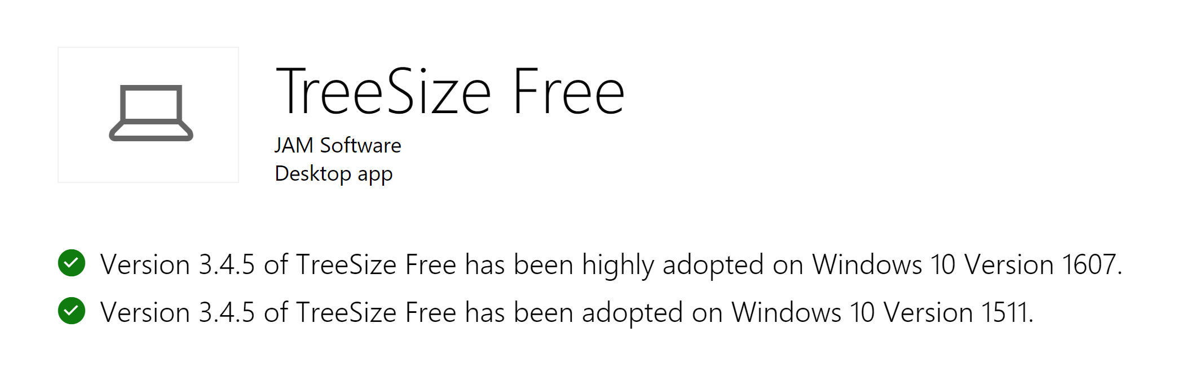
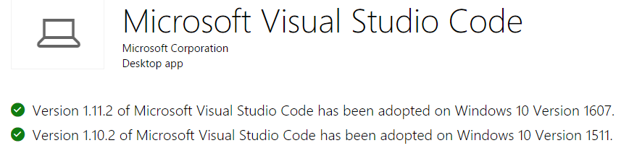
Applications - ReadyForWindoWS
Notes:
The ReadyForWindows field has the overall adoption rate and for some applications it has full version history with adoption rates. This is VERY useful information. This cannot be overstated. This is a gold mine of information.
https://developer.microsoft.com/en-us/windows/ready-for-windows#/app/?NPId=f45e74eb20392bd71988a9929da1d248&branchStatus=all

Slide 17
Will the app work!?
Still unsure?
Contact the vendor and ask.
Ready for Windows
https://developer.microsoft.com/en-us/windows/ready-for-windows#/
Application Compatibility Factory
https://technet.microsoft.com/en-us/windows/application-compatibility-factory-program.aspx
Ask the application owner to validate.
Ask your peers. (Networking FTW)
Retire / Replace / Rationalize
Notes:
The app owner is important here. Yu don’t own the application, only its deployment. Get an app owner to validate and QA it. Asking the app owner to validate has to be hardest job in the business. You are essentially asking someone to carve out time for you when they have zero incentive to do it. And they have a non-trivial risk associated with upgraded their applications… they may have non-trivial cost and security risks too. This is a job best suited for a business analyst if you can have the resources. Your problems here are non-technical. Most very non-technical. The path to success here is to be an annoying nag. And have easily accessible test VMs. This is hard work, plan accordingly!

Slide 18
Drivers, Office Add-Ons, Web Applications
The bonus materials.
Notes:
If you want to look at a migration project as a time breakdown, application packaging and rationalization should be take 90% of your time. The task sequence or deployment method is easy, its been done a thousand times by a thousand different people. You WILL figure out whatever you need to do deploy the actual operating system. Trust me when I say that is the easy part.

Slide 19
Drivers
Hardware specific applications are likely going to be identified as blockers by Windows Upgrade Readiness.
i.e. DisplayLink and Bluetooth
Resolution? Identify devices with legacy installations and upgrade them before doing the in place upgrade. You should be doing this anyway, now is a good time to start.
You can do this in a task sequence as well.
Notes:
The app owner is important here. Yu don’t own the application, only its deployment. Get an app owner to validate and QA it. Asking the app owner to validate has to be hardest job in the business. You are essentially asking someone to carve out time for you when they have zero incentive to do it. And they have a non-trivial risk associated with upgraded their applications… they may have non-trivial cost and security risks too. This is a job best suited for a business analyst if you can have the resources. Your problems here are non-technical. Most very non-technical. The path to success here is to be an annoying nag. And have easily accessible test VMs. This is hard work, plan accordingly!

Slide 20
Display Link And Bluetooth drivers
Dealing with Display Link blockers
http://www.displaylink.com/downloads/corporate
http://support.displaylink.com/knowledgebase/articles/607686
Dealing with Bluetooth blockers
Uninstall blocking versions during the sequence. Look to registry for uninstall string.
Notes:
The app owner is important here. Yu don’t own the application, only its deployment. Get an app owner to validate and QA it. Asking the app owner to validate has to be hardest job in the business. You are essentially asking someone to carve out time for you when they have zero incentive to do it. And they have a non-trivial risk associated with upgraded their applications… they may have non-trivial cost and security risks too. This is a job best suited for a business analyst if you can have the resources. Your problems here are non-technical. Most very non-technical. The path to success here is to be an annoying nag. And have easily accessible test VMs. This is hard work, plan accordingly!

Slide 21
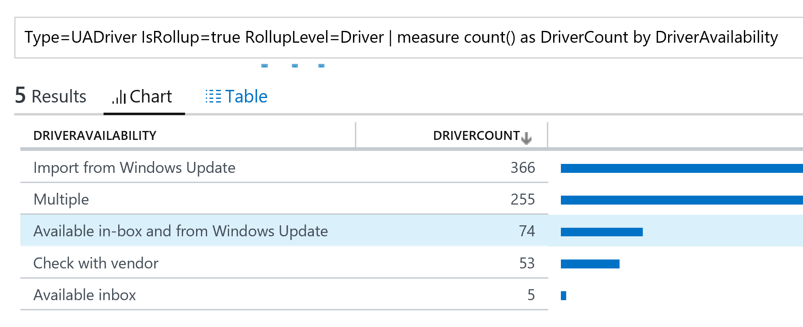
Drivers and Task Sequences

Slide 22
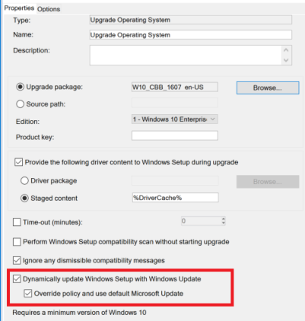
Incompatible Drivers Strategy
Use Windows Update
Identify devices with only drivers issues that are resolved using Windows Update.
Create a ConfigMgr device collection of these with a collection variable.
Have Upgrade step in TS allow dynamic updates.
This will use Windows Update to install updated drivers dynamically.
This is the easiest and best solution.
Not an easy sell… (bummer)
Notes:
This is radical!! Everyone hates this. You are likely never going to be able to have the same level of complexity in your lab environment as exists in your production environment. You can really smooth this out by using the dynamic updates steps You can spend an entire summer tracking this one down, and you may never get it right… my ask to you is at least TRY using dynamic updates, it has the potential to solve the majority of your driver issues during in place upgrades. It is a little magical really.

Slide 23
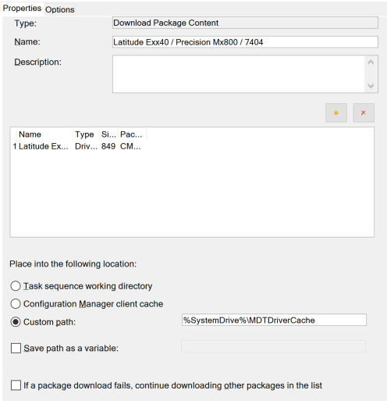
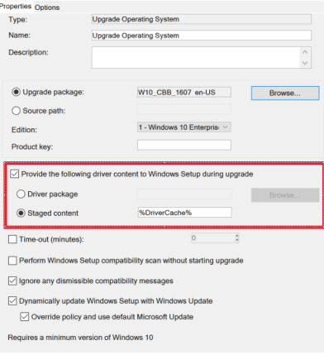
Updating Drivers Strategy
Use Cached Drivers
Device must be attached during upgrade.
Notes:
You cannot do an apply drivers step during this task sequence. You have to stage the drivers first and then tell the where the cached drivers are. This is useful if you can’t use the dynamic updates during the upgrade.
This leads to problems with disconnected devices.

Slide 24
Disconnected Peripheral Devices
Using DISM and Windows PE
Reboot the task sequence into Windows PE
Have a Run Command step that installs the steps using dism.exe
This will inject the driver regardless of if the device is present.
Be mindful of BitLocker \ 3rd party encryption.
dism /Image:C:\ /Add-Driver /Driver:.\ /Recurse
Use PNPUtil.exe in the full O.S.
Inject the driver into the Driver store.
pnputil.exe –i –a dlidusb.inf
Notes:
This is a lot of work and may not be a problem. If you are not managing these devices today, maybe you can continue to not manage them. The problem devices you are going to be running into here are specialty devices for the most part. The 1607 + latest CU has a pretty impressive library of drivers in it.
Rebooting into windows PE works great if you devices are always connected, it gets a little harry with disconnected / remote laptops. Just keep it simple where you can, using windows PE greatly increases the complexity.

Slide 25
ConfigMgr Integration
Simple yet useful integration.
Notes:
Available in 1610. Easy to integrate, can take days for information to show in the console.
Use configmgr with windows readiness integration to further dissect your windows 10 upgrade eligible devices. i.e. UEFI w/ SecureBoot and TPM AND ready according to Windows Readiness.

Slide 26
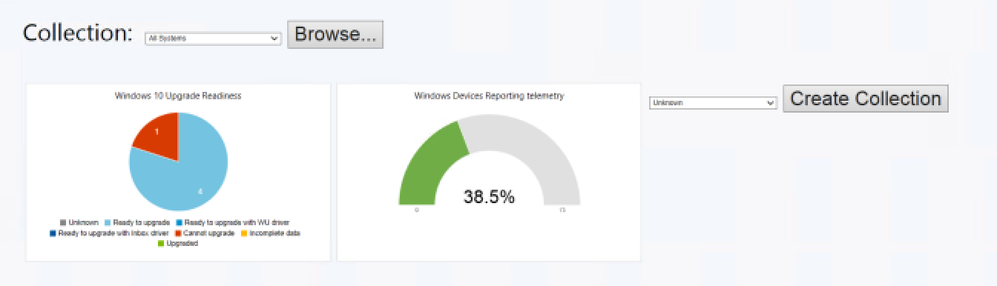
Configmgr Integration
Notes:
There just simply isn’t a lot of data available in the configmgr integration other than the pretty dashboard and abililty to create basic collections.

Slide 27
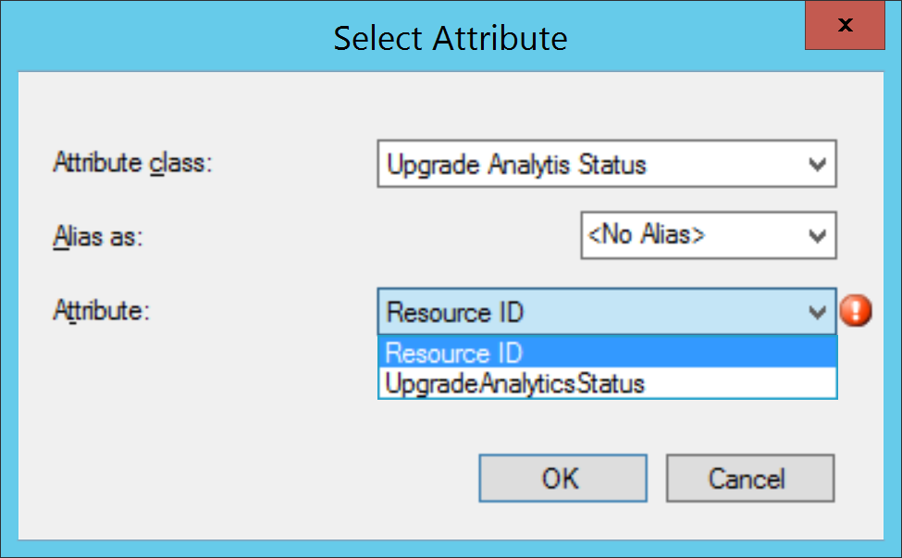
Configmgr Integration
Shows % of devices reporting telemetry
WQL - Upgrade Analytics Status
SQL View
SMS_G_System_UAComputerStatus
Status – 4=failed
select * from SMS_R_System inner join SMS_G_System_UAComputerStatus on SMS_G_System_UAComputerStatus.ResourceId = SMS_R_System.ResourceId where SMS_G_System_UAComputerStatus.UpgradeAnalyticsStatus="2"
Notes:
Even the wmi class is sparse. Just not a lot of stuff there. Your best bet is to use powershell to query WUA for devices according to whatever criteria you are looking for and then creating a collection with direct membership rules. Example, give me all devices that have an application or driver that will block the windows 10 upgrade.

Slide 28
Queries
CaSE sEnSiTiVE!

Slide 29
Query Examples
Upgrade Issues with a specific device
Computer=WIN7-05 Type=UASysReqIssue UpgradeAssessment!="Seamless upgrade" UpgradeAssessment!="No known issues“
Install Counts of Applications
UpgradeAssessment="Attention needed" Type=UAApp IsRollup=true RollupLevel=Granular Issue <> "No known i
ssues" | measure count() by AppName
Count of Issues
UpgradeAssessment="Attention needed" Type=UAApp IsRollup=true RollupLevel=Granular Issue <> "No known issues" | measure count() by Issue
Apps Blocking Upgrades
UpgradeAssessment="Attention needed" Type=UAApp IsRollup=true RollupLevel=Granular Issue = "Blocking upgrade" | measure count() by AppName

Slide 30

Query Notes
Have more than 5000 apps? Append “| Skip 5000” to your query to get items 5,001 – 10,000
Using | Measure will only return 5000 items, even in the console…
[query] | Measure count() by AppName | skip 5000
will return 0 records.
You can use wildcards. i.e. AppName = *Adobe*
Unsure of syntax or properties? Autofill works pretty well on the webform.
Notes:
The OMS query language is unique. It isn’t SQL or WQL or really anything I have seen before, it is a language all it’s own. And it is fairly new, so there isn’t a book written on it or anything. But, luckily there isn’t much to it.

Slide 31
Query Builder
The UI works well for building queries as well.
OMS query language starters
https://blogs.technet.microsoft.com/msoms/2016/01/21/easy-microsoft-operations-management-suite-search-queries/
https://docs.microsoft.com/en-us/azure/log-analytics/log-analytics-log-searches.
There is a REST API as well.
https://docs.microsoft.com/en-us/azure/log-analytics/log-analytics-log-search-api.
Notes:
The OMS query language is unique. It isn’t SQL or WQL or really anything I have seen before, it is a language all it’s own. And it is fairly new, so there isn’t a book written on it or anything. But, luckily there isn’t much to it.

Slide 32
PowerShell and Automation
The way to get extra credit on your migration project.
Notes:
If you want to look at a migration project as a time breakdown, application packaging and rationalization should be take 90% of your time. The task sequence or deployment method is easy, its been done a thousand times by a thousand different people. You WILL figure out whatever you need to do deploy the actual operating system. Trust me when I say that is the easy part.

Slide 33
PowerShell
Requirements
Read access to the Resource Group in Azure.
OMS Search API PowerShell Module
An organizational account! Not a MS account.
(Azure AD)
All the work is just Operation Insights queries, there is nothing Upgrade Readiness specific.
https://github.com/fredbainbridge/WindowsUpgradeReadiness
Using the Search API does not expose any new ways to get data from OMS.
Still 5000 record limits, etc.
Notes:
All the powershell is really just another way to report or display data. The power is being able to use that data and integrate.

Slide 34
PowerShell
QUICK DEMOS
5000 item limits, even in PowerShell.
If you can navigate PowerShell, I think it’s easier to dissect the data than using OMS search queries…
or I am bad at OMS search queries.
Notes:
All the powershell is really just another way to report or display data. The power is being able to use that data and integrate.

Slide 35
Why Not?
This is a free tool that is being routinely maintained and improved.
This is a simple dataset without much “noise”.
It is free.
Who isn’t going to use this?
Notes:
All the powershell is really just another way to report or display data. The power is being able to use that data and integrate.

Slide 37


Slide 38
Section Header
This is the next section

Slide 39
Title
Line1
Bullet Level 1
Bullet Level 2
Bullet Level 3

Slide 40
Title
Code

Slide 41
Text Only with Border
Level 1
Level 2
Level 3

Slide 42
Text Only (Red)
Level 1
Level 2
Level 3

Slide 43
Title
Text 1
Level 1
Level 2
Level 3
Text 2
Level 1
Level 2
Level 3

Slide 44
Title
Section 1
Section 2
Text
Level 1
Level 2
Level 3
Text
Level 1
Level 2
Level 3

Slide 45
Demo Title

Slide 46





























Slide 47






























Slide 48




























Slide 49




























Slide 50




























Slide 51




























Slide 52




























Slide 53























Slide 54
















